Slide 1



Process Synchronization

Slide 2


Process Synchronization
Processes can execute concurrently
May be interrupted at any time, partially completing execution
Concurrent access to shared data may result in data inconsistency
Maintaining data consistency requires mechanisms to ensure the orderly execution of cooperating processes

Slide 3
Producer Consumer Problem Revisited
Modifying the Bounded Buffer Approach for Producer and Consumer Problem.
Having a counter that keeps track of the number of full buffers.

Slide 4
Producer Consumer Problem Revisited
One possibility is to add an integer variable counter, initialized to 0.
Counter is
incremented every time
we add a new item to the buffer
decremented every time
we remove one item from the buffer.

Slide 5
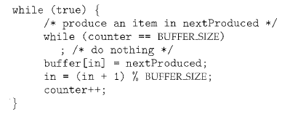
Producer Consumer Problem Revisited
The code for the producer process can be modified as follows:
Earlier Approach-
item next_produced;
while (true) {
/* produce an item in next produced */
while (((in + 1) % BUFFER_SIZE) == out)
; /* do nothing */
buffer[in] = next_produced;
in = (in + 1) % BUFFER_SIZE;
}

Slide 6
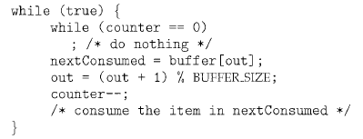
Producer Consumer Problem Revisited
The code for the consumer process can be modified as follows:
Earlier Approach-
item next_consumed;
while (true) { while (in == out)
; /* do nothing */ next_consumed = buffer[out];
out = (out + 1) % BUFFER_SIZE;
/* consume the item in next consumed */
}

Slide 7
Producer Consumer Problem Revisited
The producer and consumer routines are correct separately,
May not function correctly when executed concurrently.
Suppose that the value of the variable counter is currently 5

Slide 8
Producer Consumer Problem Revisited
The producer and consumer processes execute
the statements "counter++" and "counter--" concurrently.
Result= counter may be 4, 5, or 6!
The only correct result, counter == 5, which is generated correctly
if the producer and consumer execute separately.

Slide 9
Producer Consumer Problem Revisited
" counter++" may be implemented in machine language as –
register1 = counter
register1 = register1 + 1
counter= register1
register1 is one of the local CPU registers.
"counter--" is implemented as follows:
register2 = counter
register2 = register2 - 1
counter= register2
register2 is one of the local CPU registers.

Slide 10
Producer Consumer Problem Revisited
The concurrent execution of "counter++" and "counter--" is equivalent to
A sequential execution in which the lower-level statements presented previously are interleaved in some arbitrary order.
But the order within each high-level statement is preserved

Slide 11

Producer Consumer Problem Revisited
One such interleaving is-

Slide 12
Producer Consumer Problem Revisited
Result=> "counter == 4“, incorrect state
indicating that four buffers are full,
Correct state=five buffers are full.

Slide 13
Producer Consumer Problem Revisited
If the order of the statements at T4 and T5 is reversed, we would arrive at the incorrect state
Result=> "counter == 6“, incorrect state

Slide 14
Producer Consumer Problem Revisited
Incorrect state as
we allowed both processes to manipulate the variable counter concurrently.

Slide 15
Producer Consumer Problem Revisited
When several processes access and manipulate the same data concurrently
The outcome of the execution depends on
the particular order in which the access takes place,
Also called a Race Condition.

Slide 16
Producer Consumer Problem Revisited
To guard against the race condition,
Only one process at a time can be manipulating the variable counter.
Thus the processes must be synchronized

Slide 17
The Critical Section Problem

Slide 18
The Critical Section Problem
Consider a system consisting of n processes {Po, P1 , ... , Pn-1}.
Critical Section-
Each process has a segment of code, called a critical section in which the process may be
changing common variables,
updating a table,
writing a file, and so on.

Slide 19
The Critical Section Problem
When one process is executing in its critical section,
No other process is to be allowed to execute in its critical section.
Execution of Critical Sections by the processes is mutually exclusive
Critical-section problem is to design a protocol that the processes can use to cooperate.

Slide 20
The Critical Section Problem
Entry section
Each process must request permission to enter its critical section. The section of code implementing this request is the entry section.
Exit Section
The critical section may be followed by an exit section.
Remaining Section
The remaining code is the remaining section.

Slide 21
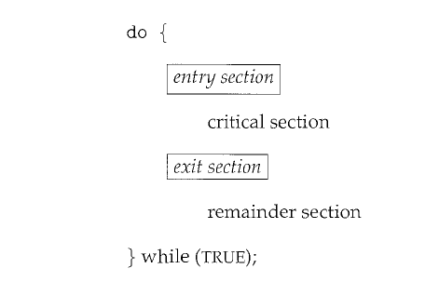
The Critical Section Problem
General Structure of a Typical Process Pi

Slide 22
The Critical Section Problem
Solution ≡ Must Satisfy three requirements-
Mutual Exclusion
Progress
Bounded Waiting

Slide 23
The Critical Section Problem
Mutual Exclusion
If Process Pi is executing in its critical section, then no other processes can be executing in their critical sections

Slide 24
The Critical Section Problem
2) Progress
If no process is executing in its critical section and
some processes wish to enter their critical sections
Then only those processes
that are not executing in their remainder sections
can participate in deciding which will enter its critical section next.
This selection cannot be postponed indefinitely.

Slide 25
The Critical Section Problem
2) Progress
Only those processes interested in entering CS , should compete to enter CS.
Only those processes wishing to enter CS, should compete for CS

Slide 26
The Critical Section Problem
3) Bounded Waiting
There exists
a bound, or
limit,
on the number of times that other processes are allowed to enter the critical sections
after a process has made a request to enter its critical section and before that request is granted.

Slide 27
The Critical Section Problem
3) Bounded Waiting
Max After a bound/time limit , after which the process definitely will get a chance to enter CS

Slide 28
The Critical Section Problem
Assumption-
Each process is executing at a nonzero speed.
No assumption concerning the relative speed of the n processes.

Slide 29
Critical-Section Handling in OS
Two approaches are used to handle critical sections in OS depending on if kernel is-
Preemptive
Non-preemptive

Slide 30
Critical-Section Handling in OS
Preemptive-
allows a process to be preempted while it is running in kernel mode.
Non-preemptive-
does not allow a process running in kernel mode to be preempted;
a kernel-mode process will run until it
exits kernel mode,
blocks, or
voluntarily yields control of the CPU.

Slide 31
Critical-Section Handling in OS
Non-preemptive kernel-
is essentially free from race conditions on kernel data structures,
as only one process is active in the kernel at a time.
Preemptive kernels-
must be carefully designed to ensure that shared kernel data are free from race conditions.
are especially difficult to design for SMP architectures,
since in these environments it is possible for two kernel-mode processes
to run simultaneously on different processors.

Slide 32
Critical-Section Handling in OS
Why would anyone favor a preemptive kernel over a nonpreemptive one? ?

Slide 33
Critical-Section Handling in OS
Why would anyone favor a preemptive kernel over a nonpreemptive one?
A preemptive kernel
is more suitable for real-time programming, as it will allow a real-time process to preempt a process currently running in the kernel.
may be more responsive, since there is less risk that a kernel-mode process will run for an arbitrarily long period before relinquishing the processor to waiting processes.

Slide 34
Solutions to The Critical Section Problem
Software Based Solutions
Hardware Based Solutions

Slide 35
Software Synchronization

Slide 36
Software Based Solutions to The Critical Section Problem
Software Based Solutions
Two process Solution
Algorithm 1
Algorithm 2
Algorithm 3/Peterson’s Solution
Multiple Process Solution

Slide 37
Software Based Solutions to The Critical Section Problem
Two process Solution
Assume that the load and store machine-language instructions are atomic;
that is, cannot be interrupted

Slide 38
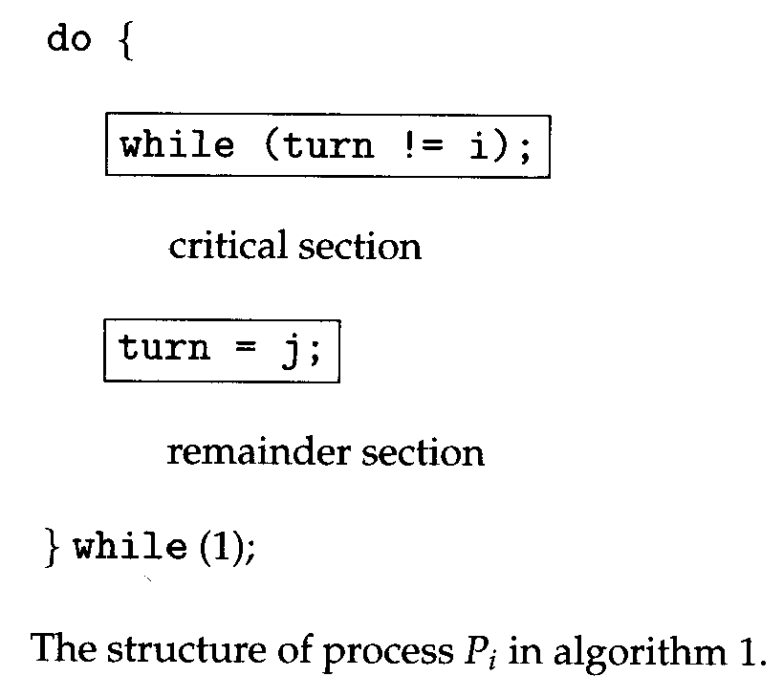
Software Based Solutions to The Critical Section Problem
Algorithm 1

Slide 39
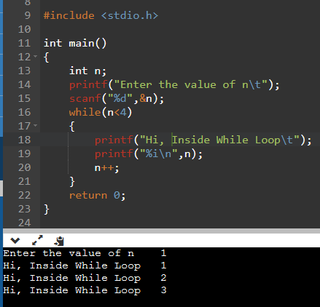
Working of While Loop without semicolon;
Example-
#include <stdio.h>
int main()
{
int n = 0;
printf("enter value of n");
scanf("%d",&n);
while(n < 4)
{
printf("Hi, Inside while loop\n");
printf("%i\n", n);
n++;
}
}

Slide 40
Working of While Loop with;
Generally we Dont write a semicolon after the condition in while loop
The problem is that the loop body becomes a semicolon, which is a do nothing statement.
This while loop has no body

Slide 41
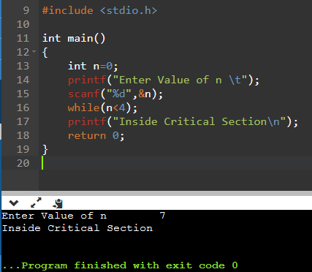
Working of While Loop with;
Trapped in while loop as Condition is true
Executes while loop with No body
Out of while loop as Condition is False
Enters CS

Slide 42
Working of While Loop with;
Example-
#include <stdio.h>
int main()
{
int n = 0;
printf("enter value of n");
scanf("%d",&n);
while(n < 4);
{
printf("Hi, Inside while loop\n");
printf("%i\n", n);
n++;
}
}

Slide 43
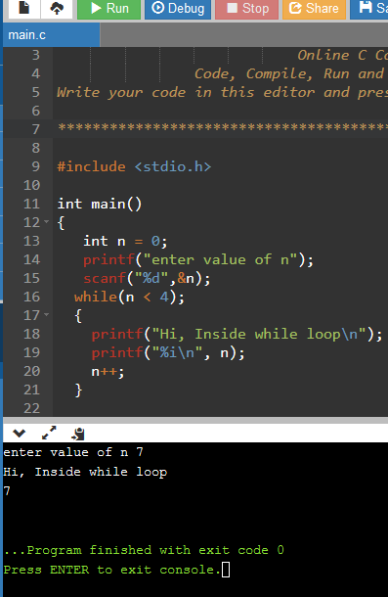
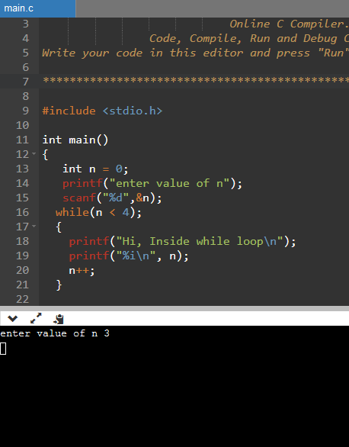
Working of While Loop with;
Condition =True,
Empty statement Executes
Infinite Loop
Print statement doesn’t execute
Condition =False,
Print statement
Executes

Slide 44
Working of While Loop with;
Condition =False,
Control comes out of Loop
Critical Section executes
Condition =True,
Empty statement Executes
Process gets trapped in Infinite Loop
Does not enter Critical Section

Slide 45
Software Based Solutions to The Critical Section Problem
Acts like a trap
Stopping processes to enter into the Critical Section
Turn=Shared Common Integer/Global Integer turn initialized to 0/1
Algorithm 1
Entry Code
Exit Code

Slide 46
Algorithm 1 : Mutual Exclusion Check If P0 is executing critical section, Can another process P1 enter the critical section or not?

Slide 47
Algorithm 1
CS=critical section
Algorithm 1- Lets initialize turn with 0
P0, i=0 | P1, i=1
do{ while(turn!=0); critical section turn=1; remainder section }while(1); | do{ while(turn!=1); critical section turn=0; remainder section }while(1);

Slide 48
Can P1 enter CS while P0 is in CS ?

Slide 49
Can P1 enter CS while P0 is in CS-No
Algorithm 1
For P0,Lets take turn=0,
while condition =false
P0 enters CS
While P0 is Inside CS, Still turn=0
P1 tries to enter the CS
P1 tries to enter CS
Still turn=0,
while condition =true
P1 gets trapped in an infinite loop
P1 is unable to enter CS
P0, i=0
do{ while(turn!=0); critical section turn=1; remainder section }while(1);
P1, i=1
do{ while(turn!=1); critical section turn=0; remainder section }while(1);
Lets initialize turn with 0

Slide 50
Can P1 enter CS while P0 is in Remainder Section ?

Slide 51
Can P1 enter CS while P0 is in Remainder Section -Yes
Algorithm 1
For P0,
After CS
Exit Code makes turn=1
Starts executing Remainder Section
Now can P1 enter CS
P1 tries to enter CS
Now turn=1,
while condition =false
P1 enters CS
P0, i=0
do{ while(turn!=0); critical section turn=1; remainder section }while(1);
P1, i=1
do{ while(turn!=1); critical section turn=0; remainder section }while(1);
CS=critical section

Slide 52
Algorithm 1 : Mutual Exclusion Check Satisfied!!!!!

Slide 53
Can P0 enter CS immediately again after completing RS?

Slide 54
Can P0 enter CS immediately again after completing RS?-No
Algorithm 1
After 1st run
turn becomes =1,
For P0
while condition =true
P0 gets trapped in an infinite loop
P0 is unable to enter CS
P0, i=0
do{ while(turn!=0); critical section turn=1; remainder section }while(1);
CS=critical section

Slide 55
Solutions to The Critical Section Problem
Algorithm 1
If turn == i, then process Pi executes in critical section
turn=0, Po executes CS
turn=1, P1 executes CS

Slide 56
Algorithm 1 : Progress Requirement Check

Slide 57
Algorithm 1 : Progress Requirement Check
After P0 comes out then P1 gets control to go inside
After P1 comes out then P0 gets control to go outside.
P0 P1

Slide 58
Algorithm 1 : Progress Requirement Check
It is Strict Alteration
Case 1-If a process doesn’t want to go to CS, still it goes due to alteration.
Case 2-If P1 doesn’t want to go in CS and P0 wants to go in CS, still P0 won’t get chance.
This Solution is not following progress

Slide 59
Algorithm 1 : Bounded Waiting Check
Process 0 can go directly and Process 1 can go after process 0 into critical section. So, Bounded waiting is satisfied.

Slide 60
Solutions to The Critical Section Problem
Algorithm 1
Mutual Exclusion is preserved
Ensures that only one process at a time can be in its critical section.
Does not satisfy, Progress Requirement
Bounded Waiting Criteria is satisfied

Slide 61
Algorithm 2
Algorithm 2
The two processes share boolean array:
Boolean flag[2]
The flag array is used to indicate if a process is ready to enter the critical section. flag[i] = true implies that process P_{i} is ready!
Boolean array can be initialized to false.
As the process wants to enter CS, its cell can be made True.
Boolean Array flag[2]
[0] | [1]
F | F

Slide 62
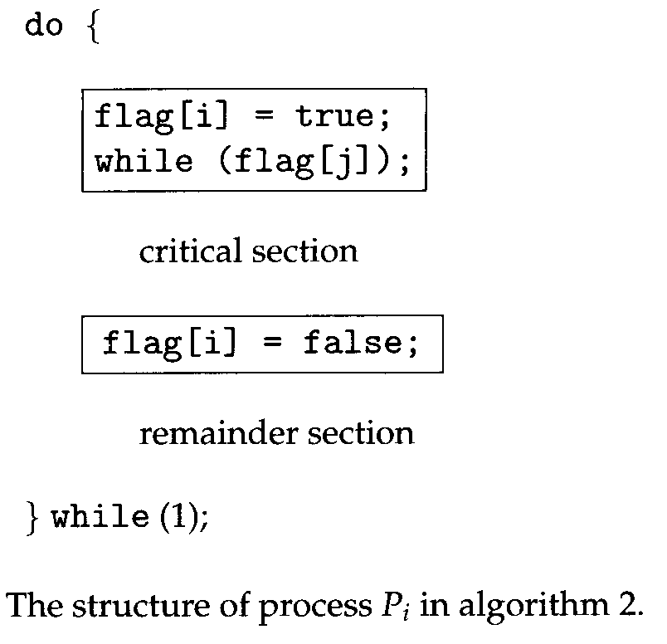
Solutions to The Critical Section Problem
Algorithm 2

Slide 63
Algorithm 2
Algorithm 2
P0,i=0 | P1,i=1
do{ flag[0]=true; while(flag[1]); critical section flag[0]=false; remainder section }while(1); | do{ flag[1]=true; while(flag[0]); critical section flag[1]=false; remainder section }while(1);

Slide 64
Algorithm 2
Algorithm 2
P0 | P1
do{ flag[0]=true; while(flag[1]); critical section flag[0]=false; remainder section }while(1); | do{ flag[1]=true; while(flag[0]); critical section flag[1]=false; remainder section }while(1);
Boolean Array flag[2]
[0] | [1]
F | F

Slide 65
Algorithm 2 : Mutual Exclusion Check If P0 is executing critical section, Can another process P1 enter the critical section or not?

Slide 66
If P0 is executing CS, Can another process P1 enter the CS or not? No
For P0
It wants to enter CS, so sets flag[0]=T
It checks If his friend P1 wants to go,
As flag[1]=F
Control Comes out of while loop
P0 executes CS
Algorithm 2
P0
do{ flag[0]=true; while(flag[1]); critical section flag[0]=false; remainder section }while(1);
P1
do{ flag[1]=true; while(flag[0]); critical section flag[1]=false; remainder section }while(1);
[0] | [1]
T | F
Boolean Array flag[2]

Slide 67
If P0 is executing CS, Can another process P1 enter the CS or not? No
For P0
It wants to enter CS, so sets flag[0]=T
It checks If his friend P1 wants to go,
As flag[1]=F
Control Comes out of while loop
P0 executes CS
P1 tries to enter CS
Sets flag[1]=T,
while condition =true
P1 gets trapped in an infinite loop
P1 is unable to enter CS
Algorithm 2
P0
do{ flag[0]=true; while(flag[1]); critical section flag[0]=false; remainder section }while(1);
P1
do{ flag[1]=true; while(flag[0]); critical section flag[1]=false; remainder section }while(1);
[0] | [1]
T | F
Boolean Array flag[2]
[0] | [1]
T | T

Slide 68
Can P1 enter CS while P0 is in Remainder Section ?

Slide 69
Can P1 enter CS while P0 is in Remainder Section ?Yes
Algorithm 2
For P0
After finishing CS
Sets flag[0]=false
Continues with RS
P1 tries to enter CS
sets flag[1]=T,
while condition =false
P1 enters CS
P0
do{ flag[0]=true; while(flag[1]); critical section flag[0]=false; remainder section }while(1);
P1
do{ flag[1]=true; while(flag[0]); critical section flag[1]=false; remainder section }while(1);
[0] | [1]
F | T
Boolean Array flag[2]

Slide 70
Algorithm 2 : Mutual Exclusion Check Satisfied!!!!!

Slide 71
Algorithm 2: Progress Requirement Check

Slide 72
Can P0 enter CS immediately again after completing RS?

Slide 73
Can P0 enter CS immediately again after completing RS? Yes
Algorithm 2
P0
do{ flag[0]=true; while(flag[1]); critical section flag[0]=false; remainder section }while(1);
If His friend P1 is not interested in CS and flag[1]=F
and If P0 wants to go again , is interested, so set flag[0]=T
while loop is false
So P0 can enter CS any number of times
[0] | [1]
T | F
F | F
Boolean Array flag[2]

Slide 74
Algorithm 2 : Progress Requirement Check
If P1 wants to go in CS again and immediately after executing RS, it can enter again if P2 is not interested in CS
Whichever process is interested , while others are not, gets to enter CS
Progress till now.

Slide 75
Algorithm 2 : Progress Requirement Check
Contradiction crops up…………….Now…

Slide 76
If both P0,P1 want to enter CS
Concurrent Execution!!!
Algorithm 2
For P0
Gets trapped in While
Infinite Loop
P0 Doesn’t enter CS
For P1
Gets trapped in While
Infinite Loop
P1 Doesn’t enter CS
P0
do{ flag[0]=true; while(flag[1]); critical section flag[0]=false; remainder section }while(1);
P1
do{ flag[1]=true; while(flag[0]); critical section flag[1]=false; remainder section }while(1);
[0] | [1]
T | T
Boolean Array flag[2]

Slide 77
Algorithm 2 : Progress Requirement Check
If Both P0,P1 want to enter CS, Both go in infinte loop, No one gets CS
Thus, No Progress.

Slide 78
Solutions to The Critical Section Problem
Algorithm 2
Mutual Exclusion is preserved
Does not satisfy, Progress Requirement.

Slide 79
Solutions to The Critical Section Problem
Now Lets us combine the concept of
both Algorithm 1 and Algorithm 2

Slide 80
Algorithm 3
Algorithm 3/Peterson’s Solution
The two processes share two variables:
int turn;
Boolean flag[2]
The variable turn indicates whose turn it is to enter the critical section
The flag array is used to indicate if a process is ready to enter the critical section. flag[i] = true implies that process P_{i} is ready!

Slide 81
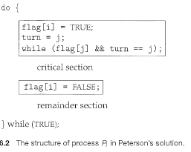
Algorithm 3
Algorithm 3/Peterson’s Solution

Slide 82
Algorithm 3
Algorithm 3
P0,i=0,j=1 | P1,i=1,j=0
do{ flag[0]=true; turn=1 while(turn==1 && flag[1]==T); critical section flag[0]=false; remainder section }while(1); | do{ flag[1]=true; turn=0 while(turn==0 && flag[0]==T); critical section flag[1]=false; remainder section }while(1);

Slide 83
Algorithm 3
Algorithm 3
P0 | P1
do{ flag[0]=true; turn=1 while(turn==1 && flag[1]==T); critical section flag[0]=false; remainder section }while(1); | do{ flag[1]=true; turn=0 while(turn==0 && flag[0]==T); critical section flag[1]=false; remainder section }while(1);
turn=0/1
Boolean Array flag[2]
[0] | [1]
F | F

Slide 84
Algorithm 3 : Mutual Exclusion Check If P0 is executing critical section, Can another process P1 enter the critical section or not?

Slide 85
If P0 is executing CS, Can another process P1 enter the CS or not? No
Case 1
For P0
Sets flag as true
turn=1
P1 is not interested
while (T&&F);
while(F);
exits while loop
P0 executes CS
P0
do{ flag[0]=true; turn=1 while(turn==1 && flag[1]==T); critical section flag[0]=false; remainder section }while(1);
P1
do{ flag[1]=true; turn=0 while(turn==0 && flag[0]==T); critical section flag[1]=false; remainder section }while(1);
[0] | [1]
T | F
turn=1
Boolean Array flag[2]

Slide 86
If P0 is executing CS, Can another process P1 enter the CS or not? No
Case 2
P1 tries to enter CS
set flag[1]=T,
turn=0
while(T&&T);
while(T);
gets trapped
goes in Infinte loop
P0
do{ flag[0]=true; turn=1 while(turn==1 && flag[1]==T); critical section flag[0]=false; remainder section }while(1);
P1
do{ flag[1]=true; turn=0 while(turn==0 && flag[0]==T); critical section flag[1]=false; remainder section }while(1);
For P0
Interested
Already Inside CS
[0] | [1]
T | T
turn=0
Boolean Array flag[2]

Slide 87
Can P1 enter CS while P0 is in Remainder Section ?

Slide 88
Can P1 enter CS while P0 is in Remainder Section ?Yes
Case 2
P1 tries to enter CS
set flag[1]=T,
turn=0
while(T&&F);
while(F);
control comes out of while loop
P1 Executes CS
P0
do{ flag[0]=true; turn=1 while(turn==1 && flag[1]==T); critical section flag[0]=false; remainder section }while(1);
P1
do{ flag[1]=true; turn=0 while(turn==0 && flag[0]==T); critical section flag[1]=false; remainder section }while(1);
For P0
after P0 comes out of CS
Sets flag to False
[0] | [1]
F | T
turn=0
Boolean Array flag[2]

Slide 89
Algorithm 3 : Mutual Exclusion Check Satisfied!!!!!

Slide 90
Algorithm 3: Progress Requirement Check

Slide 91
If both P0,P1 want to enter CS
1
2
Algorithm 3
For P0
Now P0 is also interested
sets flag as true
and turn=1
while(T&&T);
while(T);
P0 gets trapped
Now Context Switch
Doesn’t enter CS
For P1
Suppose P1 is interested
sets flag as true and turn=0
Context Switch occurs
As P0 had set turn as 1
Now P1 tries
while(F&&T);
while(F);
P1 enters CS
P0
do{ flag[0]=true; turn=1 while(turn==1 && flag[1]==T); critical section flag[0]=false; remainder section }while(1);
P1
do{ flag[1]=true; turn=0 while(turn==0 && flag[0]==T); critical section flag[1]=false; remainder section }while(1);
3
[0] | [1]
T | T
turn=0/1
Boolean Array flag[2]

Slide 92
Algorithm 3 : Progress Check Satisfied!!!!!

Slide 93
Algorithm 3 : Bounded Waiting Check Pi will enter the critical section (progress) after at most one entry by Pj (bounded waiting) i.e. P0 will enter the critical section (progress) after at most one entry by P1 (bounded waiting). Every process gets a fair chance. Satisfied!!!!!

Slide 94
Solutions to The Critical Section Problem
Algorithm 3/Peterson’s Solution
Provable that the three CS requirement are met:
1. Mutual exclusion is preserved
P_{i} enters CS only if:
either flag[j] = false or turn = i
2. Progress requirement is satisfied
3. Bounded-waiting requirement is met

Slide 95
Hardware Synchronization

Slide 96
Hardware Based Solutions to The CS Problem
Software-based solutions such as Peterson's are not guaranteed to work on modern computer architectures.

Slide 97
Hardware Synchronization
Hardware Solutions- Simple tool-a lock.
Race conditions are prevented by requiring that critical regions be protected by locks.

Slide 98
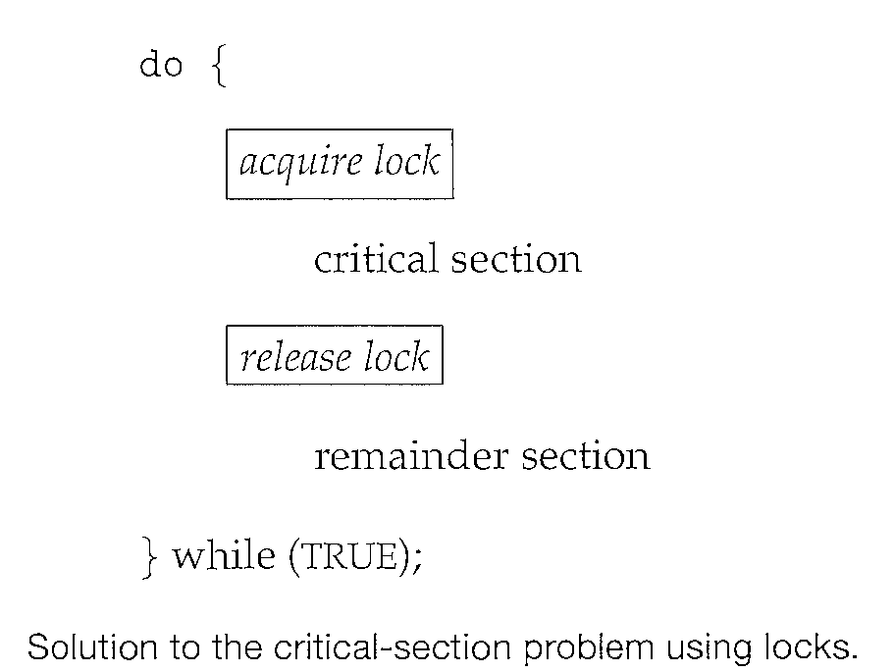
Hardware Synchronization
A process must acquire a lock before entering a critical section;
It releases the lock when it exits the critical section.

Slide 99
Hardware Synchronization
Special Atomic Hardware Instructions-
Atomic = Non-Interruptable
Test Memory word and Set value-Test and Set()
Swap contents of two memory words-Swap()

Slide 100
test_and_set Instruction
Definition:
boolean test_and_set (boolean *target)
{
boolean rv = *target;
*target = TRUE;
return rv:
}
Executed atomically
If 2 test and set instructions are executed simultaneously , they will be executed sequentially in some arbitary order.

Slide 101
test_and_set Instruction
Definition:
boolean test_and_set (boolean *target)
{
boolean rv = *target;
*target = TRUE;
return rv:
}
Returns the original value of passed parameter i.e False
Set the new value of passed parameter to “TRUE”.

Slide 102
Mutual-exclusion implementation with TestAndSet ()
Implements mutual exclusion
Lock=Shared /Global Boolean variable , initialized to FALSE

Slide 103
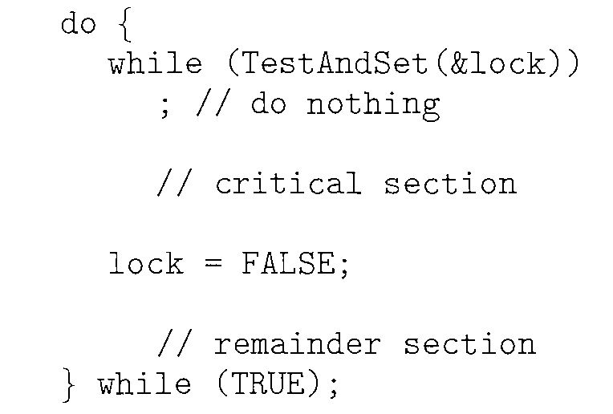
Mutual-exclusion implementation with TestAndSet ()
Solution:

Slide 104
Mutual-exclusion implementation with TestAndSet ()
P0 tries to enter CS
T&S returns False and set lock=True
While(False);
P0 comes out of while
Enter CS
Now P1 tries to enter CS
P0 is still inside CS and lock=true
Test&Set Returns the original value of passed parameter i.e. True
While(True);
Goes in Infinte Loop/Do Nothing
so P1 cannot enter CS
P0
do{ while(TestAndSet(&lock)); critical section lock=FALSE; remainder section }while(1);

Slide 105
Mutual-exclusion implementation with TestAndSet ()
After completing CS
P0 makes lock=false
Exits CS
Enters RS
Now P1 can enter CS as lock is false now
Comes out of while loop
Executes CS
P0
do{ while(TestAndSet(&lock)); critical section lock=FALSE; remainder section }while(1);

Slide 106
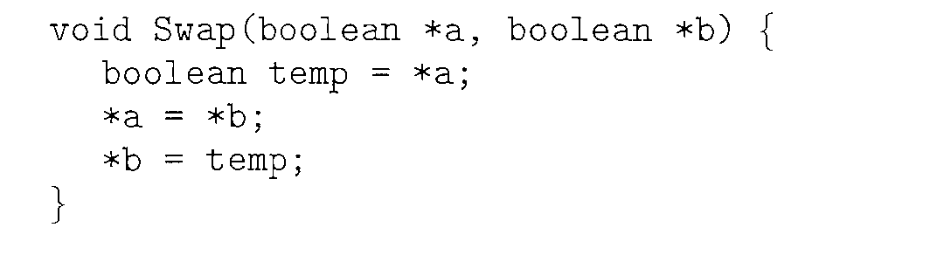
swap Instruction
Definition:
Swaps the contents of 2 memory word
Executed atomically=Non-interruptable

Slide 107
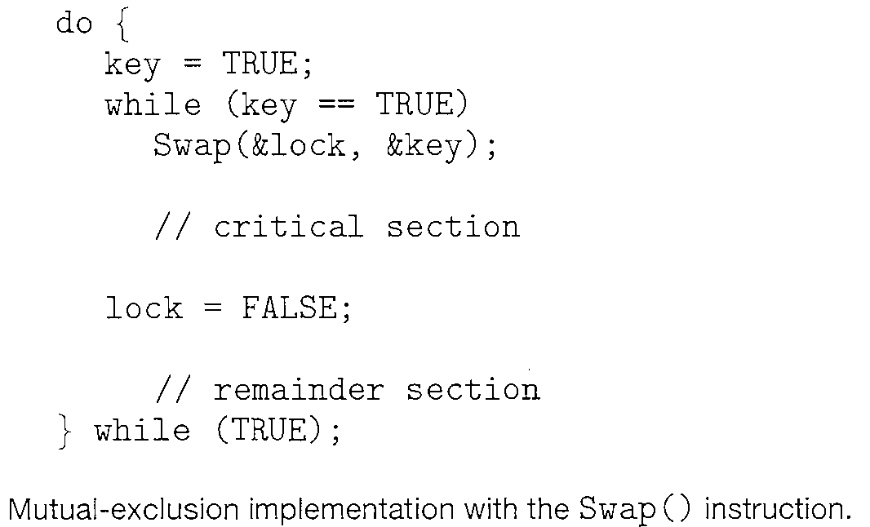
Mutual-exclusion implementation with swap ()
Solution:
Key=Local Variable=Each process has its own Key
Lock=Global Variable=Common for all Processes
Both Initialized to False

Slide 108
Mutual-exclusion implementation with swap ()
Initilally (L,K)=(F,F)
P0 makes key=true so
(L,K)=(F,T)
While key is true
Swap values of Key and Lock so
(L,K)=(T,F)
Key becomes false, exits while loop
Enters CS
Now P1 tries to enter CS
P1’s own key is also True Initially
Global Lock is True as P0 is in CS
Key=true so
(L,K)=(T,T)
After Swapping also,
Key will always be True, So trapped in while loop
P1 will not be able to enter CS
Solution:

Slide 109
Mutual-exclusion implementation with swap ()
P0
Now, Lock=False and P0 exits CS
P0 enters RS
Now P1 tries to enter CS
So Pair (L,K)=(F,T)
The value will be swapped
Key will become False
Pair(L,K)=(T,F)
Control comes out of while
Enters CS
Solution:

Slide 110
Hardware Synchronization
Test Memory word and Set value-Test and Set()
Swap contents of two memory words-Swap()
These algorithms do not satisfy the bounded waiting requirement

Slide 111
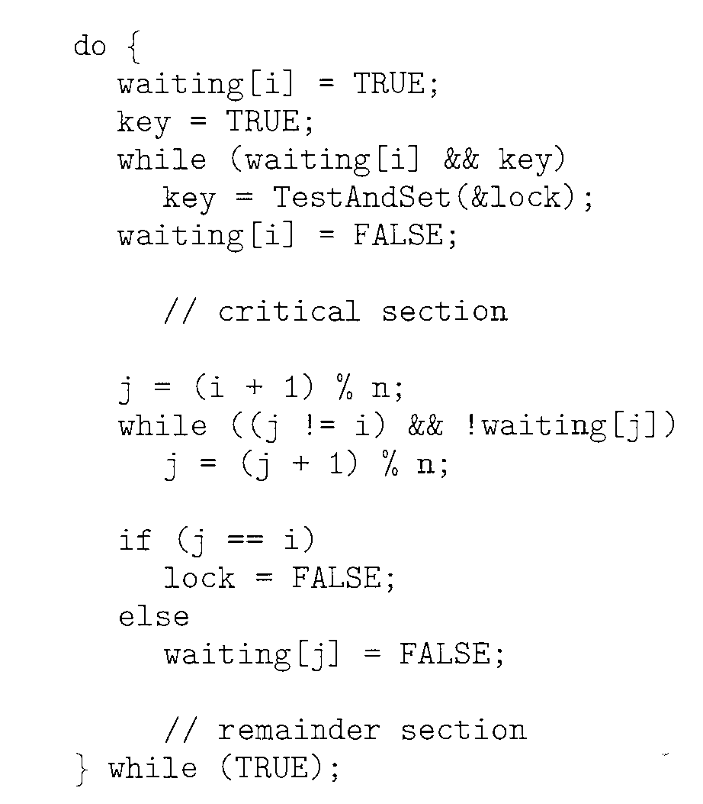
Bounded Waiting implementation with test and set ()
Solution:
Entry Code
Exit Code

Slide 112
Bounded Waiting implementation with test and set ()
Solution: Satisfies all 3 critical section requirements
Shared Data strcutures/Global variables
boolean waiting[n];
boolean lock;
Both initialized to false

Slide 113
Bounded Waiting implementation with test and set ()
Lock is initialized to False
Pi can enter its critical section only if either waiting[i]==false or key==false
The value of Key can become false only if Test&Set() is executed
The 1st process to execute the Test&Set() will set key==false and lock to True
waiting[i] of Pi=False
All other processes must wait

Slide 114
Bounded Waiting implementation with test and set ()
Lock=false
For Pi , waiting and Key both are True
while Condtn=True
Inside While Loop,
Key=T&S(&Lock)
So Key=False(Returns Original Value of Lock=False)
Lock=True
exit form While loop as Key=false
Waiting of Pi finishes=false
Enters Critical Section
Now Pj tries to enter Critical Section
waiting and key Both are True,
Lock=True
while conditn=True
Inside While Loop
Key=T&S(&Lock)
Key=True
Lock=True
Trapped in while loop

Slide 115
Bounded Waiting implementation with test and set ()
The hardware-based solutions to the CSP are complicated for application programmers to use.
Soln= Semaphore

Slide 116
Semaphore
A synchronization tool
A semaphore S is an integer variable that,
apart from initialization,
is accessed only through two standard atomic operations:
wait () and
signal ()

Slide 117
Semaphore
wait () operation = originally termed P
from the Dutch proberen,
Meaning "to test“ or “to attempt”
signal() operation = originally called V
from verhogen,
Meaning "to increment"

Slide 118
Semaphore
Classical Definition of Wait-
wait(S) {
while S <= 0
; II no-op
s--;
}
The testing of the integer value of S (S<=0), as well as its possible modification (S--), must be executed without interruption.

Slide 119
Semaphore
Classical Definition of Signal-
signal(S) {
S++;
}

Slide 120
Semaphore
All modifications to the integer value of the semaphore in the wait () and signal() operations must be executed indivisibly.
That is, when one process modifies the semaphore value, no other process can simultaneously modify that same semaphore value.

Slide 121
Usage of Semaphore
To Deal with n-process Critical Section Problem, i.e. Mutual Exclusion
binary semaphores to deal with the critical-section problem for multiple processes.
binary semaphores are known as mutex locks, as they are locks that provide mutual exclusion
To Solve Synchronization Problem

Slide 122
Types of Semaphore
Types of Semaphores
Counting
Binary

Slide 123
Types of Semaphore
Counting Semaphore-
The value of a counting semaphore can range over an unrestricted domain.
Binary Semaphore-
The value of a binary semaphore can range only between 0 and 1.
Also known as mutex locks,
As they provide mutual exclusion.

Slide 124
Counting Semaphore
Used to control access to a given resource consisting of a finite number of instances.
The semaphore is initialized to the number of resources available.

Slide 125
Counting Semaphore
Each process that wishes to use a resource performs a wait() operation on the semaphore ,
thereby decrementing the count.
When a process releases a resource, it performs a signal() operation
incrementing the count.

Slide 126
Counting Semaphore
When the count for the semaphore goes to 0, all resources are being used.
After that, processes that wish to use a resource will block until the count becomes greater than 0.

Slide 127
ISRO | ISRO CS 2017 – May | Question 78
At particular time, the value of a counting semaphore is 10, it will become 7 after: (a) 3 V operations (b) 3 P operations (c) 5 V operations and 2 P operations (d) 2 V operations and 5 P operations
Which of the following option is correct? (A) Only (b) (B) Only(d) (C) Both (b) and (d) (D) None of these

Slide 128
ISRO | ISRO CS 2017 – May | Question 78
At particular time, the value of a counting semaphore is 10, it will become 7 after: (a) 3 V operations (b) 3 P operations (c) 5 V operations and 2 P operations (d) 2 V operations and 5 P operations Which of the following option is correct? (A) Only (b) (B) Only(d) (C) Both (b) and (d) (D) None of these Answer: (C) Explanation: P: Wait operation decrements the value of the counting semaphore by 1. V: Signal operation increments the value of counting semaphore by 1. Current value of the counting semaphore = 10 a) after 3 P operations, value of semaphore = 10-3 = 7 d) after 2 v operations, and 5 operations value of semaphore = 10 + 2 – 5 = 7 Hence option (C) is correct.

Slide 129
UGC-NET | UGC NET CS 2018 July – II | Question 51
At a particular time of computation, the value of a counting semaphore is 10. Then 12 P operations and “x” V operations were performed on this semaphore. If the final value of semaphore is 7, x will be: (A) 8 (B) 9 (C) 10 (D) 11

Slide 130
UGC-NET | UGC NET CS 2018 July – II | Question 51
At a particular time of computation, the value of a counting semaphore is 10. Then 12 P operations and “x” V operations were performed on this semaphore. If the final value of semaphore is 7, x will be: (A) 8 (B) 9 (C) 10 (D) 11 Answer: (B) Explanation: Intially the value of a counting semaphore is 10 Now 12 P operation are performed. Now counting semaphore value = -2 “x” V operations were performed on this semaphore and final value of counting semaphore = 7 i.e x + (-2) = 7 x = 9. So, option (C) is correct.

Slide 131
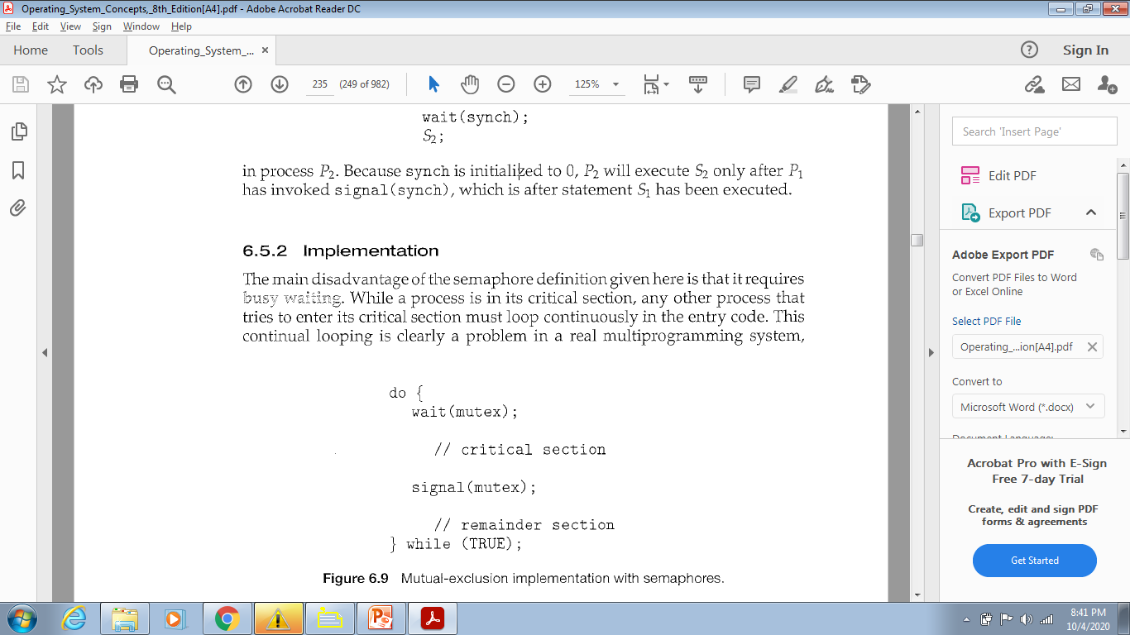
Binary Semaphore
Mutual Exclusion using Binary Semaphore
Used to deal with the critical-section problem for multiple processes.
Processes share a semaphore, mutex, initialized to 1.
wait(S) {
while S <= 0
; II no-op
s--;
}

Slide 132
Mutual Exclusion using Binary Semaphore
Process P0 tries to enter the CS
P0
while(mutex<=0);
mutex=1 so Condition is False
Comes out of while loop
mutex - -
so mutex=0
CS
Now P1 tries to enter CS
while(mutex<=0);
condition is True , so P1 gets trapped in a Do Nothing Loop
P1 cannot enter CS ============>ME preserved
wait(S) {
while S <= 0
; II no-op
s--;
}

Slide 133
Synchronization using Semaphore
We can also use semaphores to solve various synchronization problems.
Consider two concurrently running processes:
P1 with a statement S1
P2 with a statement S2 .
Suppose we require that S2 be executed only after S1 has completed.

Slide 134
Synchronization using Semaphore
Let P1 and P2 share a common semaphore synch, initialized to 0
Statements inserted in P1
S1;
signal(synch) ;
Statements inserted in P2
wait(synch);
S2;
wait(S) {
while S <= 0
; II no-op
s--;
}

Slide 135
Synchronization using Semaphore
P1
S1;
signal(synch) ;
P2
wait(synch);
S2;
Because synch is initialized to 0,
P2 will execute S2 only after P1 has invoked signal (synch), which is after statement S1 has been executed.
Else P2 will caught in infinte loop inside wait() fn

Slide 136
Semaphore
Must guarantee that no two processes can execute the wait() and signal() on the same semaphore at the same time
Thus, the implementation becomes the critical section problem
the wait and signal code are placed in the critical section

Slide 137
Busy Waiting
While a process is in its critical section,
any other process that tries to enter its critical section must loop continuously in the entry code=>Infinite Loop
This continual looping is clearly a problem in a real multiprogramming system where a single CPU is shared among many processes.
Busy waiting wastes CPU cycles that some other process might be able to use productively.

Slide 138
Busy Waiting
Disadvantage
Busy Waiting
Software Solutions i.e. Algo 1, Algo2, Peterson’s Solution and Semaphore definition
all suffer from Busy Waiting

Slide 139
Busy Waiting
While a process is in its critical section,
This type of semaphore is also called a Spinlock
The process "spins" while waiting for the lock.
Advantage of Spinlocks-
No context switch is required when a process must wait on a lock, and a context switch may take considerable time.

Slide 140
Busy Waiting
Thus, when locks are expected to be held for short times, spinlocks are useful;
Often employed on multiprocessor systems where
one thread can "spin" on one processor while
another thread performs its critical section on another processor.

Slide 141
Busy Waiting
Little busy waiting if critical section rarely occupied
Note that applications may spend lots of time in critical sections and therefore this is not a good solution

Slide 142
Semaphore Implementation with no Busy waiting

Slide 143
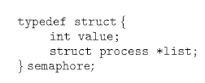
Semaphore Definition
Define a semaphore as a "C' struct
Each semaphore has
an integer value
a list of processes-”list”

Slide 144
Semaphore Definition
With each semaphore there is an associated waiting queue
Each entry in a waiting queue has two data items:
value (of type integer)
pointer to next record in the list

Slide 145
Semaphore Definition
Wait()
When a process must wait on a semaphore, it is added to the list of processes.
Signal()
A signal() operation removes one process from the list of waiting processes and awakens that process

Slide 146
Implementation with no busy waiting
We modify the definition of the wait() and signal() semaphore operations.
When a process executes the wait () operation and finds that the semaphore value is not positive, it must wait.
Rather than busy waiting, the process can block itself.

Slide 147
Implementation with no busy waiting
Two operations:
block
wakeup

Slide 148
Implementation with no busy waiting
Two operations:
block –
The block() operation suspends the process that invokes it.
place the process invoking the operation on the waiting queue associated with the semaphore
The state of the process is switched to the waiting state.
Control transferred to the CPU scheduler, which selects another process to execute.

Slide 149
Implementation with no busy waiting
wakeup –
A process that is blocked, waiting on a semaphore S, should be restarted
when some other process executes a signal() operation.
The process is restarted by a wakeup () operation

Slide 150
Implementation with no busy waiting
wakeup –
The wakeup(P) operation resumes the execution of a blocked process P.
Remove one of processes in the waiting queue and place it in the ready queue
Changes the process state from waiting to ready
These two operations are provided by the operating system as basic system calls.

Slide 151
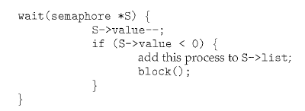
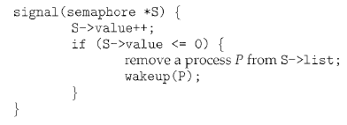
Implementation with no busy waiting

Slide 152
Implementation with no busy waiting
Semaphore values may be negative,
If a semaphore value is negative, its magnitude is the no of processes waiting on that semaphore.
Binary Semaphore values are never negative under the classical definition of semaphores with busy waiting.

Slide 153
Implementation with no busy waiting
The list of waiting processes can be easily implemented by
a link field in each process control block (PCB).
Each semaphore contains
an integer value and
a pointer to a list of PCBs.

Slide 154
Implementation with no busy waiting
One way to add and remove processes from the list
so as to ensure bounded waiting is to use a FIFO queue,
where the semaphore contains both head and tail pointers to the queue.
In general, the list can use any queueing strategy.

Slide 155
Deadlock and Starvation
Deadlock – two or more processes are waiting indefinitely for an event that can be caused by only one of the waiting processes

Slide 156
Deadlock and Starvation
The event in question is execution of signal operation
Let S and Q be two semaphores initialized to 1
P₀ P₁
wait(S); wait(Q);
wait(Q); wait(S);
... ...
signal(S); signal(Q);
signal(Q); signal(S);

Slide 157
Deadlock and Starvation
P₀ P₁
wait(S); wait(Q);
wait(Q); wait(S);
... ...
signal(S); signal(Q);
signal(Q); signal(S);
P0 executes wait(S) then P1 executes wait(Q)
When P0 executes wait(Q), it must wait until P1 executes signal(Q)
When P1 executes wait(S), it must wait until P0 executes signal (S)

Slide 158
Deadlock and Starvation
Deadlock-Every process in the set is waiting for an event that can be caused only by another waiting process in the set
Starvation – indefinite blocking
A process may never be removed from the semaphore queue in which it is suspended

Slide 159
Classical Problems of Synchronization
Classical problems used to test newly-proposed synchronization schemes
Bounded-Buffer Problem
Readers and Writers Problem
Dining-Philosophers Problem

Slide 160
Semaphore Solution to Bounded-Buffer Problem

Slide 161
Bounded-Buffer Problem
n buffers, each can hold one item
Semaphore mutex ->Binary Semaphore
Provides mutual exclusion for access to the buffer pool
initialized to the value 1
Semaphore full ->Counting Semaphore
Counts no of full buffers
initialized to the value 0
Semaphore empty ->Counting Semaphore
Counts no of empty buffers
initialized to the value n
Assuming Buffer is empty

Slide 162
Bounded-Buffer Problem
The structure of the producer process
do {
... /* produce an item in next_produced */
...
wait(empty);
wait(mutex);
... /* add next produced to the buffer */
...
signal(mutex);
signal(full);
} while (true);
Semaphore mutex
initialized to the value 1
Semaphore full
initialized to the value 0
Semaphore empty
initialized to the value n
wait(S) {
while S <= 0
; II no-op
s--;
}

Slide 163
Bounded-Buffer Problem
The structure of the producer process
do {
... /* produce an item in next_produced */
...
wait(empty);
wait(mutex);
... /* add next produced to the buffer */
...
signal(mutex);
signal(full);
} while (true);
Mutual Exclusion?
wait(S) {
while S <= 0
; II no-op
s--;
}

Slide 164
Bounded-Buffer Problem
The structure of the consumer process
do {
wait(full);
wait(mutex);
... /* remove an item from buffer to next_consumed */
...
signal(mutex);
signal(empty);
... /* consume the item in next consumed */
... } while (true);
Semaphore mutex
initialized to the value 1
Semaphore full
initialized to the value 0
Semaphore empty
initialized to the value n
wait(S) {
while S <= 0
; II no-op
s--;
}

Slide 165
Bounded-Buffer Problem
The structure of the consumer process
do {
wait(full);
wait(mutex);
... /* remove an item from buffer to next_consumed */
...
signal(mutex);
signal(empty);
... /* consume the item in next consumed */
... } while (true);
Mutual Exclusion?
wait(S) {
while S <= 0
; II no-op
s--;
}

Slide 166
Readers-Writers Problem

Slide 167
Readers-Writers Problem
Process Synchronization Problem
A Database/Data set/Object/File/Record is shared among a number of concurrent processes
Readers – only read the data set; they do not perform any updates
Writers – can both read and write i.e. update

Slide 168
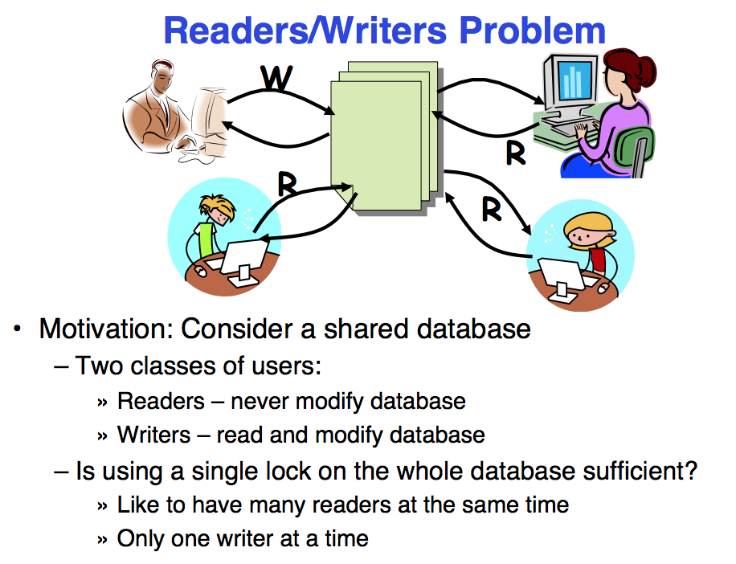

Slide 169
Readers-Writers Problem
Problem –
Allow multiple readers to read at the same time, no adverse effects
If a writer and some other process(reader/writer) access shared object simultaneously chaos may ensue
Requirements
Writers must have exclusive access to the shared object

Slide 170
Readers-Writers Problem
Problem –
R-W : Problem
W-R : Problem
W-W : Problem
R-R : No Problem

Slide 171
Reader Writer Problem
Several variations– all involving priorities
First Reader Writer Problem-
No reader will be kept waiting unless a writer has already obtained permission to use the shared object.
No reader should wait for other readers to finish simply because a writer is waiting
Second Reader Writer Problem-
Once a writer is ready , that writer performs its write as soon as possible
If a writer is waiting to access the object, no new readers may start reading

Slide 172
Solution to First Reader Writer Problem
Shared Data
Data set
Semaphore rw_mutex
Semaphore mutex
Integer read_count

Slide 173
Readers-Writers Problem
Semaphore rw_mutex
Initialized to 1
Common to both reader and writers
Mutual Exclusion semaphore for the writers
Also used by 1st or Last Reader that enters or exits CS
It is not used by readers who enter or exit while other readers are in their critical sections
Semaphore mutex
Initialized to 1
To ensure Mutual Exclusion when variable readcount is updated
Integer read_count
Initialized to 0
Keeps a track of how many processes are currently reading the object

Slide 174
Readers-Writers Problem
The structure of a writer process
do{ wait(rw_mutex);
... /* writing is performed */
...
signal(rw_mutex);
} while (true);
Semaphore rw_mutex
Mutual Exclusion for the writers
initialized to 1
wait(S) {
while S <= 0
; II no-op
s--;
}
Writer process:
Writer requests the entry to critical section.
If allowed i.e. wait() gives a true value, it enters and performs the write. If not allowed, it keeps on waiting.
If allowed, Performs writing
It exits the critical section.

Slide 175
Readers-Writers Problem
The structure of a writer process
If a writer is in the critical section and n readers are waiting,
then one reader is queued on rw_mutex, and n- 1 readers are queued on mutex.
When a writer executes signal (rw_mutex),
It resumes the execution of either the waiting readers or a single waiting writer.
The selection is made by the scheduler
do{ wait(rw_mutex);
... /* writing is performed */
...
signal(rw_mutex);
} while (true);
Semaphore rw_mutex
Mutual Exclusion for the writers
initialized to 1

Slide 176
Readers-Writers Problem
The structure of a reader process
do { wait(mutex); read_count++; if (read_count == 1)
wait(rw_mutex);
signal(mutex);
... /* reading is performed */
...
wait(mutex); read count--; if (read_count == 0)
signal(rw_mutex);
signal(mutex);
} while (true);
Semaphore rw_mutex
Mutual Exclusion for the writers
initialized to 1
Semaphore mutex
ME for readcount update
initialized to 1
read_count initialized to 0

Slide 177
Readers-Writers Problem
The structure of a reader process
do { wait(mutex); read_count++; if (read_count == 1)
wait(rw_mutex);
signal(mutex);
... /* reading is performed */
...
wait(mutex); read count--; if (read_count == 0)
signal(rw_mutex);
signal(mutex);
} while (true);
Reader process:
Reader requests the entry to critical section.
If allowed:
it increments the count of number of readers inside the critical section.
If this reader is the first reader entering, it locks the rw_mutex semaphore to restrict the entry of writers if any reader is inside.
It then, signals mutex as any other reader is allowed to enter while others are already reading.

Slide 178
Readers-Writers Problem
The structure of a reader process
do { wait(mutex); read_count++; if (read_count == 1)
wait(rw_mutex);
signal(mutex);
... /* reading is performed */
...
wait(mutex); read count--; if (read_count == 0)
signal(rw_mutex);
signal(mutex);
} while (true);
Reader process:
After performing reading, it exits the critical section.
When exiting, it checks if no more reader is inside, it signals the semaphore “rw_mutex” as now, writer can enter the critical section.
If not allowed, it keeps on waiting.

Slide 179
Readers-Writers Problem
The structure of a reader process
do { wait(mutex); read_count++; if (read_count == 1)
wait(rw_mutex); //First reader sets rw_mutex=0
//So writer cannot enter CS
//Following Readers need not enter if statement
signal(mutex);
... /* reading is performed */
...
wait(mutex); read count--; if (read_count == 0)
signal(rw_mutex); //now writers can write
//accessed by last reader
signal(mutex);
} while (true);

Slide 180
R-W Problem
The structure of a reader process
do { wait(mutex); read_count++; if (read_count == 1)
wait(rw_mutex);
signal(mutex);
... /* reading is performed */
...
wait(mutex); read count--; if (read_count == 0)
signal(rw_mutex);
signal(mutex);
} while (true);
Reader
Initially readcount=0
First Reader R1 tries to enter
wait mutex so mutex=0
readcount=1
if readcount is one i.e. First reader
wait rw_mutex so rw_mutex=0
readcount updation finished so signal mutex, mutex=1
Reader enters CS
“Reader R1 is reading”
Writer
Now Writer tries to enter
It executes his code
wait(rw_mutex)
gets trapped in infinite loop as rw_mutex was already 0
Writer cannot enter CS
do{ wait(rw_mutex);
... /* writing is performed */
...
signal(rw_mutex);
} while (true);

Slide 181
W-R Problem
The structure of a reader process
do { wait(mutex); read_count++; if (read_count == 1)
wait(rw_mutex);
signal(mutex);
... /* reading is performed */
...
wait(mutex); read count--; if (read_count == 0)
signal(rw_mutex);
signal(mutex);
} while (true);
Writer1
Initally rw_mutex=1
First Writer W1 tries to enter CS
wait operation
rw_mutex becomes 0
Writer W1 enters CS
Reader1
Initially mutex=1,readcount=0
Now reader R1 tries to enter CS
wait mutex
mutex=0
readcount=1
In if section,
wait(rw_mutex)
gets trapped in infinite loop
Reader Cannot enter CS
do{ wait(rw_mutex);
... /* writing is performed */
...
signal(rw_mutex);
} while (true);

Slide 182
W-W Problem
The structure of a reader process
do { wait(mutex); read_count++; if (read_count == 1)
wait(rw_mutex);
signal(mutex);
... /* reading is performed */
...
wait(mutex); read count--; if (read_count == 0)
signal(rw_mutex);
signal(mutex);
} while (true);
Writer1
Initally rw_mutex=1
First Writer W1 tries to enter CS
wait operation
rw_mutex becomes 0
Writer W1 enters CS
Writer2
Another Writer W2 tries to enter CS
wait operation
rw_mutex was already 0
Thus trapped in Infinite loop
Writer2 Cannot enter CS
wait(S) {
while S <= 0
; II no-op
s--;
}
do{ wait(rw_mutex);
... /* writing is performed */
...
signal(rw_mutex);
} while (true);

Slide 183
R-R Problem
Reader1
Initially readcount=0
First Reader R1 tries to enter
wait mutex so mutex=0
readcount=1
if readcount is one i.e. First reader
wait rw_mutex so rw_mutex=0
readcount updation finished so signal mutex,
mutex=1
Reader enters CS
“Reader R1 is reading”
The structure of a reader process
do { wait(mutex); read_count++; if (read_count == 1)
wait(rw_mutex);
signal(mutex);
... /* reading is performed */
...
wait(mutex); read count--; if (read_count == 0)
signal(rw_mutex);
signal(mutex);
} while (true);
Reader2
Reader R2 tries to enter CS
wait mutex so mutex=0
readcount=2
Does not enter If section
readcount updation finished so signal mutex,
mutex=1
Reader R2 Enters CS
do{ wait(rw_mutex);
... /* writing is performed */
...
signal(rw_mutex);
} while (true);

Slide 184
Readers-Writers Problem
Both Soln may lead to Starvation
First Reader Writer Problem-
Writers may starve
Second Reader Writer Problem-
Readers may starve
For this reason, other variants of the problem have been proposed.
Problem is solved on some systems by kernel providing reader-writer locks

Slide 185
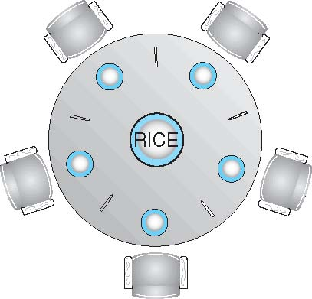
Dining-Philosophers Problem
5 Philosophers spend their lives alternating thinking and eating

Slide 186
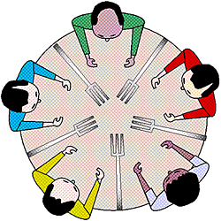
Dining-Philosophers Problem
When thinking
Don’t interact with their neighbors
When hungry-
A philosopher needs both their right and left chopstick to eat.
A hungry philosopher may only eat if there are both chopsticks available

Slide 187
Dining-Philosophers Problem
Occasionally try to pick up 2 chopsticks that are closest to her to eat from bowl
Chopsticks that are between her and her left and right neighbor
Pick up only one at a time
Need both to eat, then release both when done

Slide 188
Dining-Philosophers Problem
Classic Synchronization problem
Example of large class of concurrency control problems
Represents the need to allocate several resources among several processes
in a deadlock free and starvation free manner

Slide 189
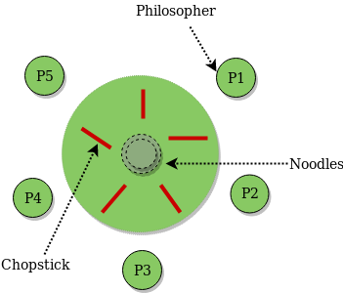
Dining-Philosophers Problem
5 Philosophers share a common circular table
Surrounded by 5 chairs=each belonging to one philosopher
Center of table ->Bowl of rice
Five single chopsticks

Slide 190
Dining-Philosophers Problem
Shared data?
Bowl of rice (data set)
Semaphore chopstick [5] initialized to 1

Slide 191
Semaphore Solution for Dining-Philosophers Problem
Grab the chopstick –By Executing wait operation on the semaphore
Release the chopstick-By executing the signal operation on the appropriate semaphore
Array of Semaphores chopstick [5] initialized to 1

Slide 192
Semaphore Solution for Dining-Philosophers Problem Algorithm
The structure of Philosopher i:
do {
wait (chopstick[i] );
wait (chopStick[ (i + 1) % 5] );
// eat
signal (chopstick[i] );
signal (chopstick[ (i + 1) % 5] );
// think
} while (TRUE);
Philosopher i has picked up the chopsticks on his sides.
Then the eating function is performed.
Philosopher i has eaten and put down the chopsticks on his sides.
Then the philosopher goes back to thinking.

Slide 193
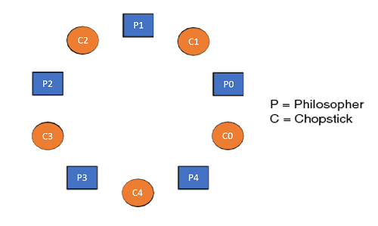
Semaphore Solution for Dining-Philosophers Problem Algorithm
do {
wait (chopstick[i] );
wait (chopStick[ (i + 1) % 5] );
// eat
signal (chopstick[i] );
signal (chopstick[ (i + 1) % 5] );
// think
} while (TRUE);
do {
i=0
wait (chopstick[0] );
wait (chopStick[1] );
// eat
signal (chopstick[0] );
signal (chopstick[1] );
// think
} while (TRUE);

Slide 194
Semaphore Solution for Dining-Philosophers Problem Algorithm
do {
i=1
wait (chopstick[1] );
wait (chopStick[2] );
// eat
signal (chopstick[1] );
signal (chopstick[2] );
// think
} while (TRUE);
do {
i=2
wait (chopstick[2] );
wait (chopStick[3] );
// eat
signal (chopstick[2] );
signal (chopstick[3] );
// think
} while (TRUE);

Slide 195
Semaphore Solution for Dining-Philosophers Problem Algorithm
do {
i=3
wait (chopstick[3] );
wait (chopStick[4] );
// eat
signal (chopstick[3] );
signal (chopstick[4] );
// think
} while (TRUE);
do {
i=4
wait (chopstick[4] );
wait (chopStick[4+1%5=0] );
// eat
signal (chopstick[4] );
signal (chopstick[0] );
// think
} while (TRUE);

Slide 196
Semaphore Solution for Dining-Philosophers Problem Algorithm
What is the problem with this algorithm?

Slide 197
Semaphore Solution for Dining-Philosophers Problem Algorithm
Algorithm Guarantees that No two neighbors are eating simultaneously
Still Must be rejected
Why?

Slide 198
Semaphore Solution for Dining-Philosophers Problem Algorithm
Why?
Possibility of deadlock
If all 5 philosophers are hungry simultaneously and each grabs left chopstick
All elements of chopsticks will be =0
When each philosopher tries to grab her right chopstick, delayed forever

Slide 199
Semaphore Solution for Dining-Philosophers Problem Algorithm
Deadlock handling
Allow at most 4 philosophers to be sitting simultaneously at the table.
Allow a philosopher to pick up the forks only if both are available (picking must be done in a critical section)
Use an asymmetric solution --
Odd-numbered philosopher picks up first the left chopstick and then the right chopstick.
Even-numbered philosopher picks up first the right chopstick and then the left chopstick

Slide 200
Problems with Semaphores
Incorrect use of semaphore operations:
signal (mutex) …. wait (mutex)
wait (mutex) … wait (mutex)
Omitting of wait (mutex) or signal (mutex) (or both)
Deadlock and starvation are possible.

Slide 201
Q1)The program follows to use a shared binary semaphore T.
Process A
int Y;
A1: Y = X*2;
A2: X = Y;
signal(T);
Process B
int Z;
B1: wait(T);
B2: Z = X+1;
X = Z;
T is set to 0 before either process begins execution and, as before, X is set to 5. Now, how many different values of X are possible after both processes finish executing? a) one b) two c) three d) four

Slide 202
Q1)The program follows to use a shared binary semaphore T.
Process A
int Y;
A1: Y = X*2;
A2: X = Y;
signal(T);
Process B
int Z;
B1: wait(T);
B2: Z = X+1;
X = Z;
T is set to 0 before either process begins execution and, as before, X is set to 5. Now, how many different values of X are possible after both processes finish executing? a) one b) two c) three d) four
Explanation: The semaphore T ensures that all the statements from A finish execution before B begins.
So now there is only one way in which statements from A and B can be interleaved: A1 A2 B1 B2: X = 11.
Ans c)

Slide 203
Q2) The bounded buffer problem is also known as ____________ a) Readers – Writers problem b) Dining – Philosophers problem c) Producer – Consumer problem d) None of the mentioned

Slide 204
Q2) The bounded buffer problem is also known as ____________ a) Readers – Writers problem b) Dining – Philosophers problem c) Producer – Consumer problem d) None of the mentioned
Answer: c

Slide 205
Q3) All processes share a semaphore variable mutex, X initialized to 1.
Each process must execute wait(mutex) before entering the critical section and signal(mutex) afterward.
Suppose a process executes in the following manner:
signal(mutex)
______
critical section
________
wait(mutex);
In this situation _____________________
a deadlock will occur
processes will starve to enter critical section
several processes maybe executing in their critical section
all of the mentioned

Slide 206
Q3) All processes share a semaphore variable mute, X initialized to 1.
Each process must execute wait(mutex) before entering the critical section and signal(mutex) afterward.
Suppose a process executes in the following manner:
signal(mutex)
______
critical section
________
wait(mutex);
In this situation _____________________
a deadlock will occur
processes will starve to enter critical section
several processes maybe executing in their critical section
all of the mentioned
Answer: c

Slide 207
Q4) All processes share a semaphore variable mutex, X initialized to 1.
Each process must execute wait(mutex) before entering the critical section and signal(mutex) afterward.
Suppose a process executes in the following manner:
waitl(mutex)
______
critical section
________
wait(mutex);
In this situation _____________________
a deadlock will occur
processes will starve to enter critical section
several processes maybe executing in their critical section
all of the mentioned

Slide 208
Q4) All processes share a semaphore variable mutex initialized to 1.
Each process must execute wait(mutex) before entering the critical section and signal(mutex) afterward.
Suppose a process executes in the following manner:
waitl(mutex)
______
critical section
________
wait(mutex);
In this situation _____________________
a deadlock will occur
processes will starve to enter critical section
several processes maybe executing in their critical section
all of the mentioned
Answer: a

Slide 209
Q5) In the bounded buffer problem, there are the empty and full semaphores that ____________ a) count the number of empty and full buffers b) count the number of empty and full memory spaces c) count the number of empty and full queues d) none of the mentioned

Slide 210
Q5) In the bounded buffer problem, there are the empty and full semaphores that ____________ a) count the number of empty and full buffers b) count the number of empty and full memory spaces c) count the number of empty and full queues d) none of the mentioned
Answer: a

Slide 211
Q6) The wait operation of the semaphore basically works on the basic _______ system call. a) stop() b) block() c) hold() d) wait()

Slide 212
Q6) The wait operation of the semaphore basically works on the basic _______ system call. a) stop() b) block() c) hold() d) wait()
Answer: b

Slide 213
Monitors

Slide 214
Monitors
A high-level synchronization construct
Set of programmer defined operators

Slide 215
Syntax of Monitors
monitor monitor-name
{
// shared variable declarations
procedure P1 (…) { …. }
procedure Pn (…) {……}
Initialization code (…) { … }
}

Slide 216
Monitors
Declaration of variables
whose value define the state of an instance of the type
Bodies of procedures
that implement operations on the type
monitor monitor-name
{
// shared variable declarations
procedure P1 (…) { …. }
procedure Pn (…) {……}
Initialization code (…) { … }
}

Slide 217
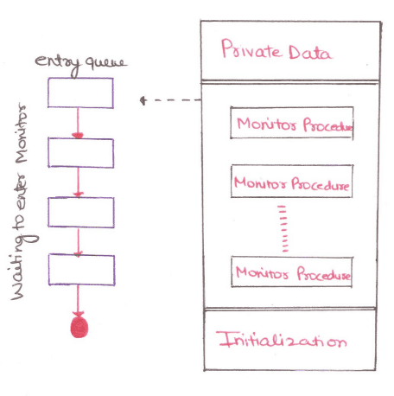
Monitors
Internal variables only accessible by code within the procedure
Procedure defined within the monitor can access only those variables
declared locally within the monitor and
its formal parameters.

Slide 218
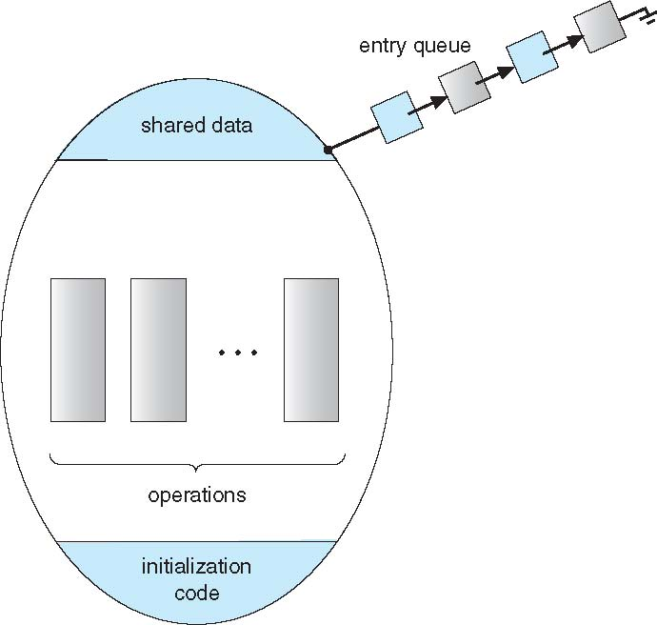
Schematic view of a Monitor

Slide 219
Monitors
It is the collection of condition variables and procedures combined together in a special kind of module or a package.

Slide 220
Monitors
The processes running outside the monitor can’t access the internal variable of the monitor but can call procedures of the monitor.

Slide 221
Monitors
Only one process at a time can execute code inside monitors.
Monitor ensures that
Only one process may be active within the monitor at a time

Slide 222
Monitors
Prgmr does not need to
code the synchronization constraint explicitly
But not powerful enough to model some synchronization schemes
Need to define additional condition construct

Slide 223
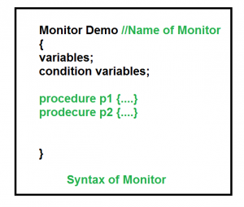
Condition Variables
Prgmr can define one or more condition variables
condition x, y;
Only Two operations are allowed on a condition variable:
x.wait()
x.signal()

Slide 224
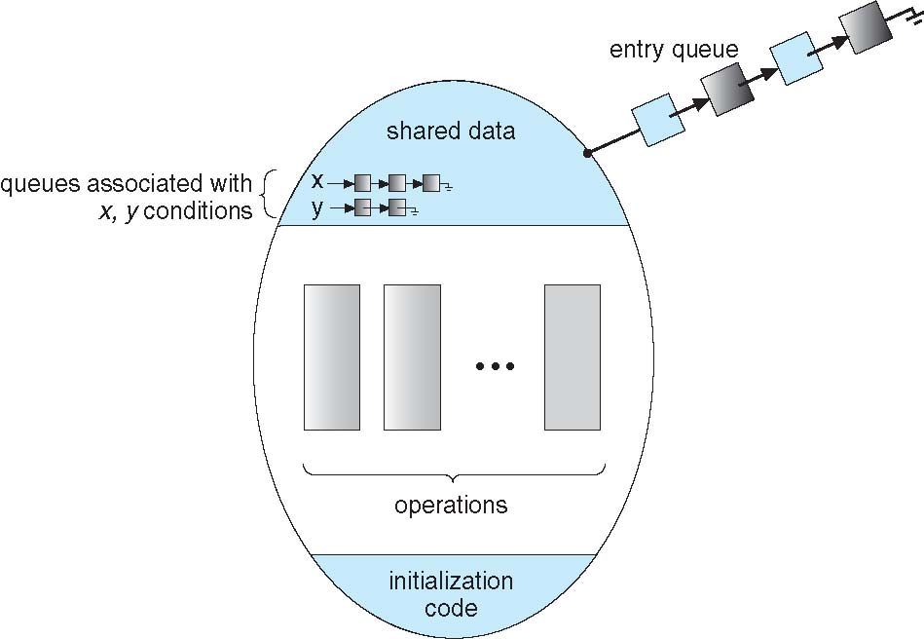
Condition Variables
x.wait() –
Process performing wait operation on any condition variable are suspended.
suspended until x.signal()
The suspended processes are placed in block queue of that condition variable.

Slide 225
Condition Variables
x.signal() –
When a process performs signal operation on condition variable, one of the blocked processes is given chance.
resumes one of processes (if any) that invoked x.wait()
If no process is suspended, then it has no effect on the variable
State of x, As if the operation was never executed
In contrast to semaphore, state of semaphore always gets affected

Slide 226
Monitor with Condition Variables

Slide 227
Condition Variables Choices
If process P invokes x.signal(), and process Q is suspended in x.wait(),
Suspended process Q associated with condition x is invoked
what should happen next?

Slide 228
Condition Variables Choices
Both Q and P cannot execute in parallel.
If Q is resumed, then P must wait
Otherwise both P and Q will be active simultaneously within the monitor

Slide 229
Condition Variables Choices
Options include
Signal and wait – P waits until Q either leaves the monitor or it waits for another condition
Signal and continue – Q waits until P either leaves the monitor or it waits for another condition

Slide 230
Condition Variables Choices
Since P was already executing in the monitor,
Option 2 seems more reasonable
However, If P continues, the logical condition for which Q was waiting may no longer hold by the time Q is resumed
Both have pros and cons – language implementer can decide
Monitors implemented in Concurrent Pascal compromise
P executing signal immediately leaves the monitor, Q is resumed
Some languages that do support monitors are Java, C#, Visual Basic, Ada, Mesa and concurrent Euclid.

Slide 231
Monitors
Advantages of Monitor:
Make parallel programming easier and
less error prone than using techniques such as semaphore.
Disadvantages of Monitor:
Monitors have to be implemented as part of the programming language .
The compiler must generate code for them.
This gives the compiler the additional burden of having to know what operating system facilities are available to control access to critical sections in concurrent processes.

Slide 232
Monitor Solution to Dining Philosophers
Deadlock free solution to Dining Philosophers Problem
To distinguish amongst the 3 states in which the philosopher may be-
enum { THINKING; HUNGRY, EATING) state [5] ;
Philosopher i can set the variable state [i] = EATING only
if her two neighbors are not eating
(state [ (i +4) % 5] ! = EATING) and (state [ (i +1) % 5] != EATING)
Left Neighbour and Right Neighbour

Slide 233
Monitor Solution to Dining Philosophers
Philosopher i can set the variable state [i] = EATING only
if her two neighbors are not eating
(state [ (i +4) % 5] ! = EATING) and (state [ (i +1) % 5] != EATING)
i=3,P3
state(i+1), state P4,Right Neighbour
state(i+4)%5,7%5,state P2,Left Neighbour

Slide 234
Monitor Solution to Dining Philosophers
Also need to declare
condition self[5];
in which i^{th} philosopher can delay herself when she is hungry but is unable to obtain the chopsticks she needs.
Distribution of chopsticks is controlled by the monitor DiningPhilosophers

Slide 235
Monitor Solution to Dining Philosophers
monitor DiningPhilosophers
{
enum { THINKING; HUNGRY, EATING) state [5] ;
condition self [5];
void pickup (int i) {
state[i] = HUNGRY;
test(i);
if (state[i] != EATING)
self[i].wait;
}
Pickup chopsticks
If unable to eat, waits to be signaled
Philosopher can delay herself when she is hungry but is unable to obtain the chopsticks she needs.

Slide 236
Monitor Solution to Dining Philosophers
monitor DiningPhilosophers
{
void putdown (int i) {
state[i] = THINKING;
// test left and right neighbors
test((i + 4) % 5);
test((i + 1) % 5);
}
Put down chopsticks
if right neighbor R=(i+1)%5 is hungry and
both of R’s neighbors are not eating,
set R’s state to eating and wake up neighbour R by signaling

Slide 237
Monitor Solution to Dining Philosophers
void test (int i) {
if ((state[(i + 4) % 5] != EATING) && (state[i] == HUNGRY) &&(state[(i + 1) % 5] != EATING) ) {
state[i] = EATING ;
self[i].signal () ;
}
}
initialization_code() {
for (int i = 0; i < 5; i++)
state[i] = THINKING;
}
}
If her two neighbors are not eating and she is hungry
I.E. if my left and right neighbors are not eating
Set her state as eating
signal() has no effect during Pickup(),
but is important to wake up waiting hungry philosophers during Putdown()

Slide 238
Solution to Dining Philosophers
Each philosopher i invokes the operations pickup() and putdown() in the following sequence:
DiningPhilosophers.pickup(i);
EAT
DiningPhilosophers.putdown(i);
No deadlock, but starvation is possible

Slide 239
Solution to Dining Philosophers
Each philosopher, before starting to eat, must invoke the operation pickup().
This act may result in the suspension of the philosopher process.
After the successful completion of the operation, the philosopher may eat.
After eating, philosopher invokes putdown() and start to think

Slide 240
Solution to Dining Philosophers
Execution of Pickup(), Putdown() and test() are all mutually exclusive, i.e. only one at a time can be executing
No 2 neighbors are eating simultaneously
So No deadlock, but starvation is possible

